Slide 1
Decision Trees

Slide 2
Decision Trees -
Algorithms used for both Classification and Regression
DT can be looked at like “rules” that can be understood by humans and implemented on datasets
Split dataset on one feature / variable → most significant feature
DT represents an inverted tree having the following attributes:
Decision node : Test for split of an attribute
Leaf node : value of the target attribute
Edge : split of an attribute
Path : a series of test to arrive at the final decision
Using recursion, sub-trees are formed based on features not used in the higher nodes
Divide and rule
DT splits data until it reaches a “pure” state
Pure subset is one where there are only positive outcomes. No further split
Works well in the training dataset as the data is “known”

Slide 3
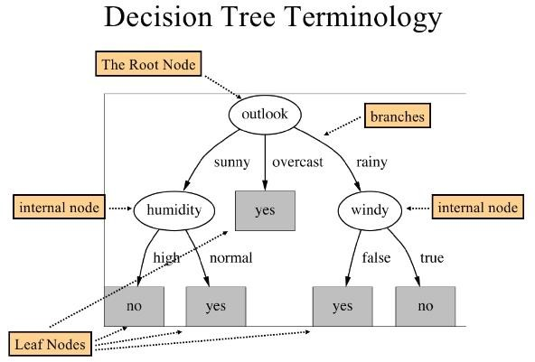

Slide 4
Predict whether someone will buy or sell stocks
Day | company_perf | exchange_rate | gold_price | Action
1 | High | Increase | Stable | Sale
2 | Medium | Increase | Unstable | Purchase
3 | High | Increase | Unstable | Purchase
4 | Medium | Decrease | Stable | Purchase
5 | Low | Decrease | Unstable | Purchase
6 | Medium | Increase | Stable | Sale
7 | High | Decrease | Stable | Purchase
8 | Medium | Increase | Stable | Sale
9 | High | Increase | Stable | Sale
10 | Medium | Decrease | Unstable | Purchase
11 | High | Decrease | Stable | Purchase
12 | Medium | Increase | Stable | Sale
13 | Medium | Decrease | Unstable | Purchase
14 | Low | Increase | Stable | Purchase
15 | Low | Increase | Stable | Purchase
Company_perf Exch_rate Gold_price
High, Medium, Low Increase, Decrease Stable, Unstable
Action
9 Purchase / 6 Sale
16 | Low | Decrease | Stable | ????

Slide 5
company_perf
High
Medium
Low
3 P / 2 S
1 | High | Increase | Stable
3 | High | Increase | Unstable
7 | High | Decrease | Stable
9 | High | Increase | Stable
11 | High | Decrease | Stable
4 P / 3 S
2 | Medium | Increase | Unstable
4 | Medium | Decrease | Stable
6 | Medium | Increase | Stable
8 | Medium | Increase | Stable
10 | Medium | Decrease | Unstable
12 | Medium | Increase | Stable
13 | Medium | Decrease | Unstable
5 | Low | Decrease | Unstable
14 | Low | Increase | Stable
15 | Low | Increase | Stable
3 P / 0 S

Slide 6
company_perf
High
Medium
Low
4 P / 3 S
2 | Medium | Increase | Unstable
4 | Medium | Decrease | Stable
6 | Medium | Increase | Stable
8 | Medium | Increase | Stable
10 | Medium | Decrease | Unstable
12 | Medium | Increase | Stable
13 | Medium | Decrease | Unstable
5 | Low | Decrease | Unstable
14 | Low | Increase | Stable
15 | Low | Increase | Stable
3 P / 0 S
Exchange rate
Increase
Decrease
1 P / 2 S
1 | High | Increase | Stable
3 | High | Increase | Unstable
9 | High | Increase | Stable
7 | High | Decrease | Stable
11 | High | Decrease | Stable
2 P / 0 S

Slide 7
company_perf
High
Medium
Low
4 P / 3 S
2 | Medium | Increase | Unstable
4 | Medium | Decrease | Stable
6 | Medium | Increase | Stable
8 | Medium | Increase | Stable
10 | Medium | Decrease | Unstable
12 | Medium | Increase | Stable
13 | Medium | Decrease | Unstable
5 | Low | Decrease | Unstable
14 | Low | Increase | Stable
15 | Low | Increase | Stable
3 P / 0 S
Exchange rate
Increase
Decrease
7 | High | Decrease | Stable
11 | High | Decrease | Stable
2 P / 0 S
gold_price
Stable
Unstable
1 | High | Increase | Stable
9 | High | Increase | Stable
3 | High | Increase | Unstable
0 P / 2 S
1 P / 0 S

Slide 8
company_perf
High
Medium
Low
5 | Low | Decrease | Unstable
14 | Low | Increase | Stable
15 | Low | Increase | Stable
3 P / 0 S
Exchange rate
Increase
Decrease
7 | High | Decrease | Stable
11 | High | Decrease | Stable
2 P / 0 S
Exchange rate
gold_price
Increase
Decrease
Stable
Unstable
2 | Medium | Increase | Unstable
6 | Medium | Increase | Stable
8 | Medium | Increase | Stable
12 | Medium | Increase | Stable
4 | Medium | Decrease | Stable
10 | Medium | Decrease | Unstable
13 | Medium | Decrease | Unstable
 | 1 | High | Increase | Stable
 | 9 | High | Increase | Stable
0 P / 2 S
3 | High | Increase | Unstable
1 P / 0 S
1 P / 3 S
3 P / 0 S

Slide 9
company_perf
High
Medium
Low
5 | Low | Decrease | Unstable
14 | Low | Increase | Stable
15 | Low | Increase | Stable
3 P / 0 S
Exchange rate
Increase
Decrease
7 | High | Decrease | Stable
11 | High | Decrease | Stable
2 P / 0 S
Exchange rate
gold_price
Increase
Decrease
Stable
Unstable
4 | Medium | Decrease | Stable
10 | Medium | Decrease | Unstable
13 | Medium | Decrease | Unstable
 | 1 | High | Increase | Stable
 | 9 | High | Increase | Stable
0 P / 2 S
3 | High | Increase | Unstable
gold_price
1 P / 0 S
3 P / 0 S
Stable
Unstable
6 | Medium | Increase | Stable
8 | Medium | Increase | Stable
12 | Medium | Increase | Stable
2 | Medium | Increase | Unstable
0 P / 3 S
1 P / 0 S

Slide 10
To summarize …
company_perf
High
Medium
Low
Purchase
Exchange rate
Increase
Decrease
Purchase
gold_price
Exchange rate
Increase
Decrease
Stable
Unstable
Purchase
Sell
Purchase
gold_price
Stable
Unstable
Sell
Purchase

Slide 11
company_perf
High
Medium
Low
Purchase
Exchange rate
Increase
Decrease
Purchase
gold_price
Exchange rate
Increase
Decrease
Stable
Unstable
Purchase
Sell
Purchase
gold_price
Stable
Unstable
Sell
Purchase
Day | company_perf | exchange_rate | gold_price | Action
16 | Low | Decrease | Stable | ????

Slide 12
Decision Trees
Conditions for split can be given (during the model building process). For example:
Don’t split node if an attribute has same values
Don’t split node if the number of children < 2
Etc…
Advantages
Interpretable
Easy to understand
Scalable
Robust
With more features, Trees can grow large and may become difficult to understand
Smaller trees have better accuracy than larger trees
Test dataset may become difficult to generalise (tips example)

Slide 13
Split criteria
Information Gain
Significant variable to split is determined by
Information Gain
Measure that determines how well a given
attribute splits the dataset
This measure is used at every step to determine the next best attribute
Information (I) is needed to classify an object
Gain (S, A) = E(S) – Ʃ [ (S_{a}/S) * E(S_{a}) ]
where
E(S) = Entropy calculation
S_{a} = Dataset having attribute value a
S = Total count of dataset of attribute A E(S_{a}) = Entropy of Attribute value a
Maximum(Gain(A) ) → Best Attribute
Entropy (I)
Measures homogeneity of the sets
Tells us how pure / impure a set is
e.g. In a binary classification dataset, if S is the dataset having + and – classes, then Entropy (Information) is measured as:
E(S) = -p₍₊₎log₂ p₍₊₎ – p₍₋₎log₂p₍₋₎
where
p₍₊₎ = % of positive class
= % of negative class
Interpretation of Entropy
0 <= I <= 1
Number of bits that is needed to identify if an item in the given dataset is + or –
For a pure subset, number of bits = 0
For a tie, number of bits = 1
^{p}(-)
Refer to chart

Slide 14
Which attribute to split on?
10 P / 5 S
company_perf | Purchase (+) | Sale (-) | PS_Total | ^{p}(+) | log₂ p₍₊₎ | ^{-p}(+) ^{log}2 ^{p}(+) | ^{p}(-) | log₂ p₍₋₎ | ^{p}(-) ^{log}2 ^{p}(-) | E
High | 3 | 2 | 5 | 0.600 | -0.737 | 0.442 | 0.400 | -1.322 | -0.529 | 0.971
Low | 3 | 0 | 3 | 1.000 | 0.000 | 0.000 | 0.000 | 0.000 | 0.000 | 0.000
Medium | 4 | 3 | 7 | 0.571 | -0.807 | 0.461 | 0.429 | -1.222 | -0.524 | 0.985
Set (Total) | 10 | 5 | 15 | 0.667 | -0.585 | 0.390 | 0.333 | -1.585 | -0.528 | 0.918
company_perf | Purchase | Sale
High | 3 | 2
Low | 3 | 0
Medium | 4 | 3
E(S) | S | ^{S}(v=high) | ^{E(}v=high⁾ | (S_{a}/S) * E(S_{a}) | ^{S}(v=medium) | ^{E(}v=medium⁾ | (S_{a}/S) * E(S_{a}) | Gain(S, company_perf)
0.918 | 15 | 5 | 0.971 | 0.324 | 7 | 0.985 | 0.460 | 0.783
10 P / 5 S
exchange_rate | Purchase (+) | Sale (-) | PS_Total | ^{p}(+) | log₂ p₍₊₎ | ^{-p}(+) ^{log}2 ^{p}(+) | ^{p}(-) | log₂ p₍₋₎ | ^{p}(-) ^{log}2 ^{p}(-) | E
Decrease | 6 | 0 | 6 | 1.000 | 0.000 | 0.000 | 0.000 | 0.000 | 0.000 | 0.000
Increase | 4 | 5 | 9 | 0.444 | -1.170 | 0.520 | 0.556 | -0.848 | -0.471 | 0.991
Set (Total) | 10 | 5 | 15 | 0.667 | -0.585 | 0.390 | 0.333 | -1.585 | -0.528 | 0.918
exchange_rate | Purchase | Sale
Decrease | 6 | 0
Increase | 4 | 5
E(S) | S | ^{S}(v=decrease) | ^{E(}v=decrease⁾ | (S_{a}/S) * E(S_{a}) | ^{S}(v=increase) | ^{E(}v=increase⁾ | (S_{a}/S) * E(S_{a}) | Gain(S, exchange_rate)
0.918 | 15 | 6 | 0.000 | 0.000 | 9 | 0.991 | 0.595 | 0.595
10 P / 5 S
gold_price | Purchase (+) | Sale (-) | PS_Total | ^{p}(+) | log₂ p₍₊₎ | ^{-p}(+) ^{log}2 ^{p}(+) | ^{p}(-) | log₂ p₍₋₎ | ^{p}(-) ^{log}2 ^{p}(-) | E
stable | 5 | 5 | 10 | 0.500 | -1.000 | 0.500 | 0.500 | -1.000 | -0.500 | 1.000
unstable | 5 | 0 | 5 | 1.000 | 0.000 | 0.000 | 0.000 | 0.000 | 0.000 | 0.000
Set (Total) | 10 | 5 | 15 | 0.667 | -0.585 | 0.390 | 0.333 | -1.585 | -0.528 | 0.918
gold_price | Purchase | Sale
Stable | 5 | 5
Unstable | 5 | 0
E(S) | S | ^{S}(v=stable) | ^{E(}v=stable⁾ | (S_{a}/S) * E(S_{a}) | ^{S}(v=unstable) | ^{E(}v=medium⁾ | (S_{a}/S) * E(S_{a}) | Gain(S, company_perf)
0.918 | 15 | 10 | 1.000 | 0.667 | 5 | 0.000 | 0.000 | 0.667
Pure
Impure

Slide 15
Pruning the Decision Tree
Pruning is a technique to reduce the size of the Decision Tree by eliminating certain sections of the tree that provide little information to classify instances
company_perf
High
Medium / Low
Purchase
Pruning a tree is done to prevent overfitting; thereby improving accuracy
Exchange rate
Select the tree size that minimises the cross-validated error (R has in-built function for this)
Increase
Decrease
Purchase
Pruning the Decision Tree
Pre-pruning : Chi-square test
Post-pruning : Pruning techniques to reduce the tree size (recommended)
gold_price
Stable
Unstable
Sell
Purchase

Slide 16
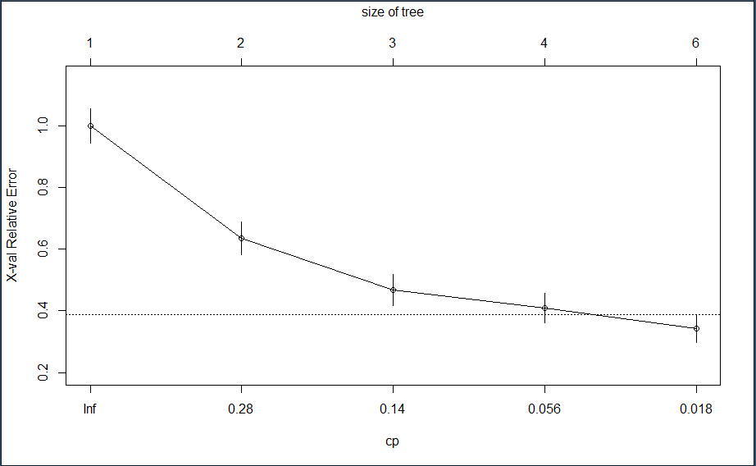
Pruning is done using a technique known as “Complexity Parameter”
Post pruning, perform prediction with the pruned tree
Compare the results with the pre-pruned model to check effectiveness
Plotcp() provides a graphical representation of the cross-validation error summary

